Slide 1
Our Geography Learning Journey
To identify what I have learnt
To describe and compare the human and physical similarities and differences between an area of the UK and a contrasting non-European country.
To explain the impact of pollution on the environment
Key vocabulary:
Physical feature
Human feature
Beach
Sea
Country
Coast
Google Earth
United Kingdom
School Trip
Identify what I already know.
To identify human/physical features the UK.

Slide 2
WB Monday 15th April 2024
LQ: Can I identify what I already know?
Steps to Success
All: I can recall the four countries in the UK and their capital cities.
Most: I can use an atlas to find the UK and the seas around the UK.
Some: I can explain how to use a map to find the four countries.

Slide 3
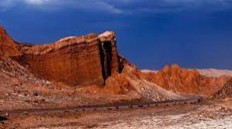
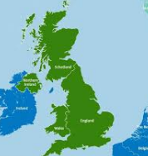
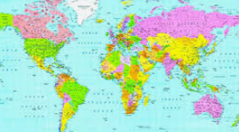
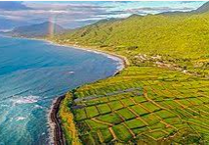
LQ: Can I identify what I already know?
STAR WORDS
Human feature Capital Cities UK
Map/ atlas Country Coast/ ocean Google Earth
Physical feature

Slide 4
LQ: Can I identify what I already know?
TPs – What did you do on WOW Day?
How does it relate to our topic ‘Sand, Sea and Sun?’
WOW DAY PICTURES HERE!

Slide 5
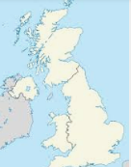
LQ: Can I identify what I already know?
Starter
TP. What is this a country? What can you remember about it?

Slide 6
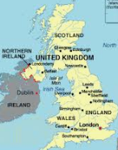
LQ: Can I identify what I already know?
This term in Geography we are going to recap our knowledge of the four countries in the UK as well as their capital cities. We are also going to be looking at the seas that surround the UK. We are also going to learn about human and Physical Features of the UK as well as making comparisons of the features between the UK and another non- European country. We are going to be using different resources throughout this term such as using atlases, maps and google earth.
Notes:
Explain what surround means and explain non European

Slide 7
LQ: Can I identify what I already know?
This country is the UK.
TP. What do you remember about the UK? Look through your books from year 1, as this will help you to remember facts about the UK.
TP. Can you recall the 4 countries in the UK?
There are 4 countries that make up the UK. They are
England, Scotland, Wales and Northern Ireland.
TP. What country do we live in?
UK | United Kingdom | United Kingdom Song | A Geography Song About the UK and its Capitals (youtube.com)
Notes:
Listen to the video

Slide 8
LQ: Can I identify what I already know?
Each of these 4 countries in the UK have Capital Cities.
TP. Can you name these capital cities?
The capital city of England is London.
The capital city of Wales is Cardiff.
The capital city of Scotland is Edinburgh.
The capital city of Northern Ireland is Belfast.
TP. Can you remember any information about these 4 countries? for example the national flower of Wales is a daffodil.
Self Assessment
Do you understand that the UK is made up of 4 countries and each country has capital cities?
Notes:
With these discussion, teacher should be writing the childrens voice on the page and then stick in books.

Slide 9
LQ: Can I identify what I already know?
We are now going to look at atlas.
TP. What is an atlas? How do you use it?
An atlas is a book of maps and charts that show areas of the world as well as the seas that surround the countries.
TP. What do you notice about an atlas? What does it have? (contents and index page)
Self Assessment
Do you understand what atlas is used for and how to use it?
Children to have theses resources on tables, as they can work in pairs/ groups
Notes:
Discuss the use of the contents, index and how it is organised. Model how to find the UK using a political map in the atlas, then model how to find the four countries of the UK.

Slide 10
LQ: Can I identify what I already know?
TP. Why does an atlas have an index and contents page?
Open and explore your atlas and discuss these questions with your partner.
TP: Can you find the 4 countries of the UK?
What oceans/seas surround the UK?
What other features can you see?
Can you find the nearest city to where you live?
What places would you like to visit?
Write on A3 sheet!
Self Assessment
Do you know what to do?
Notes:
After time come back as a class to discuss findings. Teacher’s lets print A3 sheet with the UK and write all this information on it. Put on the learning wall.

