Slide 1
Our Maths Learning Journey
Place value to 100
Compare numbers up to 100
Order numbers up to 100
Key vocabulary:
Fraction – whole, half, halves, quarter, quarters
Position & Direction - turn, position, direction, half turn, quarter turn, three-quarter turn, whole turn, left­, right, in between, ­forwards, backwards, above, below,­ top, middle, bottom ,up, down ­
Place value - 100, number square, pattern, tens, ones, place value, place value grid, partition, ­ how many?, sequence, fewer, smaller, less than, greater than, equal to, (=) ­ greatest, biggest, ­ fewest, smallest, ­count­, number bonds to 100
Place value to 100
Partition numbers up to 100
Compare numbers up to 100
Place value to 100
Explore number patterns
Partition numbers up to 100
Position and Directions
Finding quarters
Half turns
Quarter turns
Position and Directions
Describe directions and positions
Place value to 100
Find one more/ less than a 100
Describe number patterns
Fractions
Finding halves
Finding quarters

Slide 2
Monday 22nd April 2024

Slide 4
L.Q. can we read numerals in words. 1-10
24.04.2023

Slide 5
22.04.24
LQ: Can I find quarters?
Steps to success
I can confidently find a quarter of each shape.
I can explain my method of finding a quarter.

Slide 6
Star words
equal
quarter/ quarters
whole
unequal

Slide 7
LQ: Can I find quarters?
22.04.24
TP: how many equal parts is a quarter?
TP: does this show 4 quarters? How do you know?
https://www.youtube.com/watch?v=VMWa6dDoicc
Start video clip at 45 seconds.

Slide 8
LQ: Can I find quarters?
22.04.24
https://www.youtube.com/watch?v=ryGvCNDoAR0
Remember 4 quarters are 4 equal parts!
1
No, it does not show 4 quarters because there are 5 equal parts.
2
3
4
5
Notes:
Teacher to model on whiteboard using 10’s frame and cubes.

Slide 9
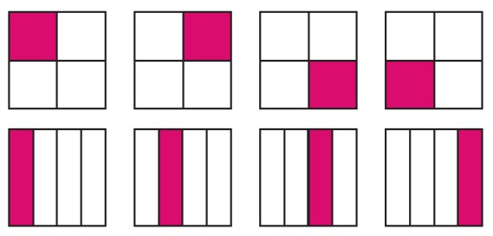
LQ: Can I find quarters?
22.04.24
TPs: Are these boards split into equal parts? How do you know?
Both boards are split into quarters.
Each coloured section shows 1 quarter
of 4 equal parts.

Slide 10
LQ: Can I find quarters?
22.04.24
TPs: Are any of these boards split into quarters?
This board is not split into quarters.
The parts are not equal.

Slide 11
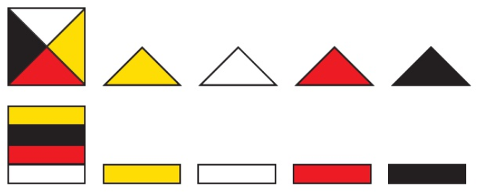
LQ: Can I find quarters?
22.04.24
This board are split into 4 equal parts.
The boards are split into quarters.

Slide 12
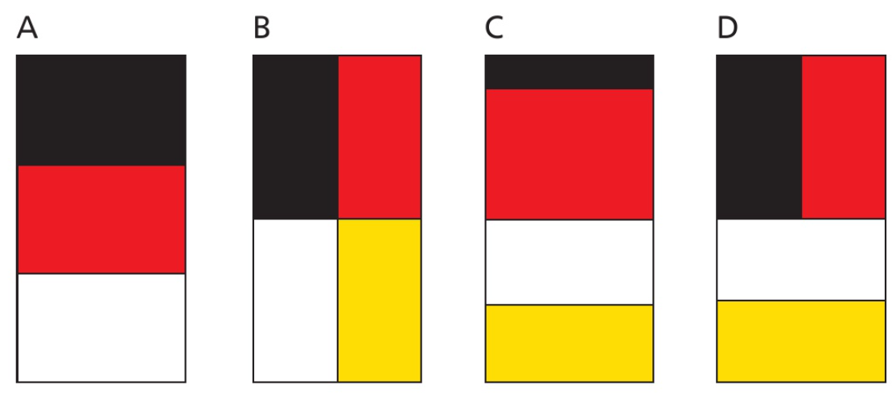
LQ: Can I find quarters?
22.04.24
TPs: Which of these boards are split into quarters?
Boards ______ and _____ are split into quarters.

Slide 13
LQ: Can I find quarters?
22.04.24
Draw lines to make 4 equal parts.
Self assessment
Do you understand that quarters need to have 4 equal parts?

Slide 14
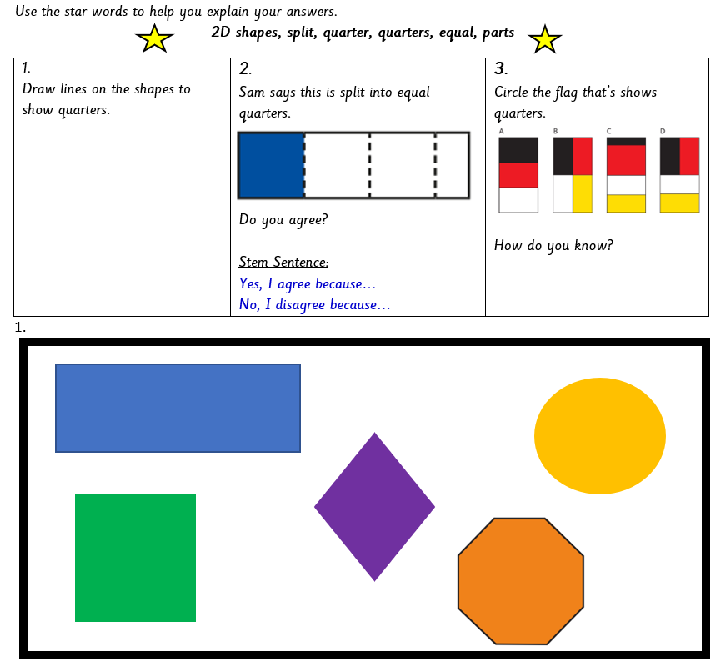
Task
LQ: Can I find quarters?
22.04.24
Self assessment
Do you understand the tasks?

Slide 15
Tuesday 23rd April 2024

Slide 16
L.Q. Can I understand bonds to 20?
23.04.24
Let’s make number bonds to song.
https://www.youtube.com/watch?v=MmLMU8BqyKw

Slide 17
23.04.24
LQ: Can I find quarters for amounts?
Steps to success
I understand what a quarter is.
I can confidently find a quarter of each amount.
I can explain my method of finding a quarter.

Slide 18
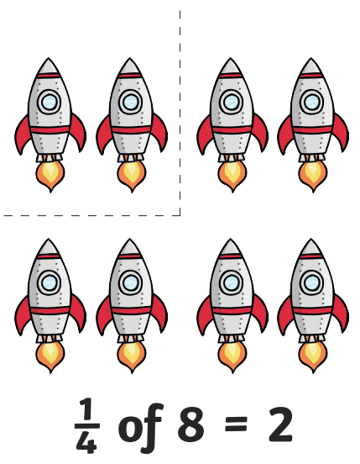
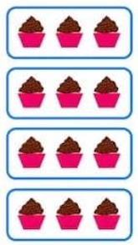
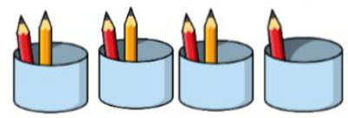
Star words
fractions
whole / total amount
equal
unequal
quarter / quarters

Slide 19
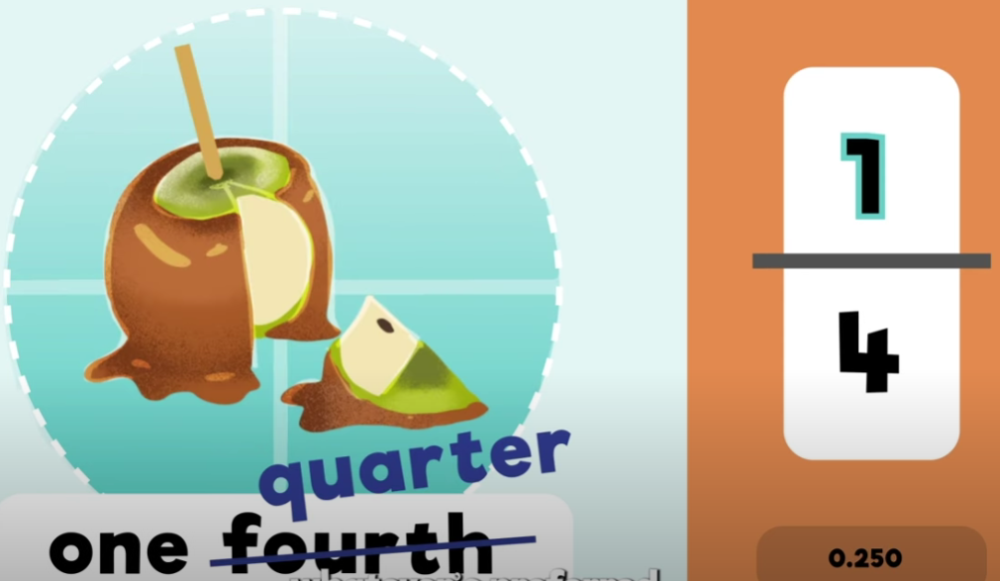
LQ: Can I find quarters for amounts?
23.04.24
TPs: What is a quarter?
A quarter is ___ of four equal parts.
Today we are going to practice finding a quarter for amounts.
https://www.youtube.com/watch?v=5lHXd1cJcMQ

Slide 20
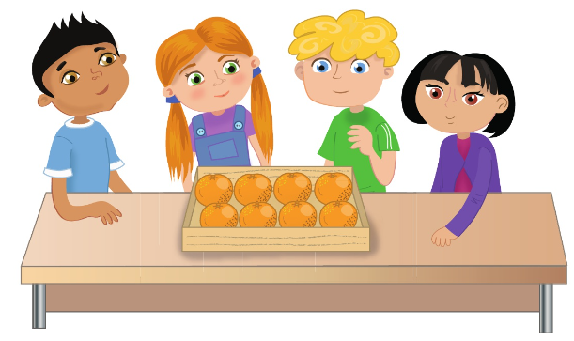
LQ: Can I find quarters for amounts?
23.04.24
The children share 8 oranges equally.
TPs: How many oranges does each child get?

Slide 21
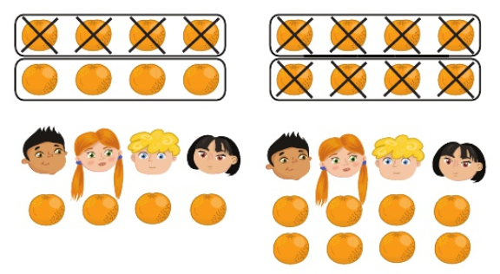
LQ: Can I find quarters for amounts?
23.04.24
The oranges are shared one by one between the 4 children.
Each child gets 2 oranges.
1 quarter of 8 is 2.
We can split them in 2 different ways into quarters.

Slide 22
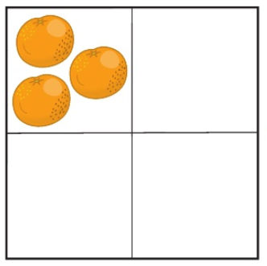
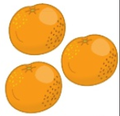
LQ: Can I find quarters for amounts?
23.04.24
This is a quarter of a whole amount.
TPs: What is the whole?
Let’s put three oranges in each quarter.
The whole is 12.

Slide 23
LQ: Can I find quarters for amounts?
23.04.24
Share these into quarters and complete the statement.
___ orange is a quarter of 4 oranges.
Adult to use the crossing out method when sharing one by one.

Slide 24
LQ: Can I find quarters for amounts?
23.04.24
Share these into quarters and complete the statement.
___ cherries is a quarter of 20 cherries.
Adult to use the crossing out method when sharing one by one.

Slide 25
LQ: Can I find quarters for amounts?
23.04.24
Let’s count the plums and share them into quarters.
TPs: What is a quarter?
A quarter of ____ plums is _____ plums.
Self assessment
Do you understand how to find 1
quarter of an amount?
Adult to use the crossing out method when sharing one by one.

Slide 26
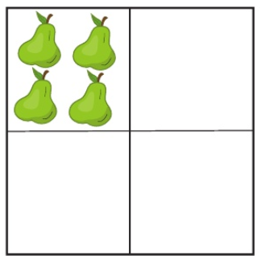
LQ: Can I find quarters for amounts?
23.04.24
A quarter is 4 pears. What is the whole?
Let’s find the missing quarters and complete the statement.
The whole is ____ pears.

Slide 27
LQ: Can I find quarters for amounts?
23.04.24
Tiny is trying to find a quarter of 24.
What mistake has Tiny made?
What should Tiny’s bar model look like?

Slide 28
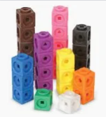
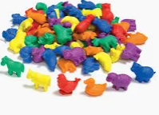
Task
LQ: Can I find quarters for amounts?
23.04.24
Count the number of objects for the corresponding numbers.
Split the amounts into quarters and say what 1 quarter is.
12 16 20 24 28
The whole number is ______.
1 quarter is of _____ is _____.
Self assessment
Do you understand the task?

Slide 29
Wednesday 24th April 2024

Slide 30
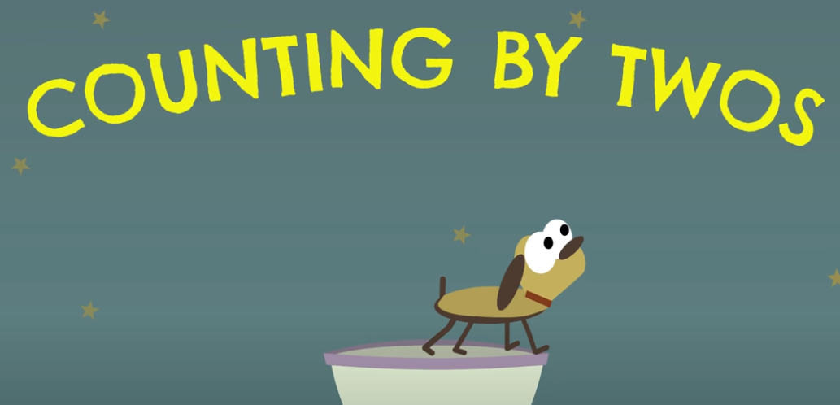
L.Q. Can I count by 2s?
24.04.24
Let’s sing the counting by 2 song.
https://www.youtube.com/watch?v=GvTcpfSnOMQ

Slide 31
24.04.24
LQ: Can I find quarters for amounts?
Steps to success
I understand what a quarter is.
I can confidently find a quarter of each amount.
I can explain my method of finding a quarter.

Slide 32
Star words
fractions
whole / total amount
equal
unequal
quarter / quarters

Slide 33
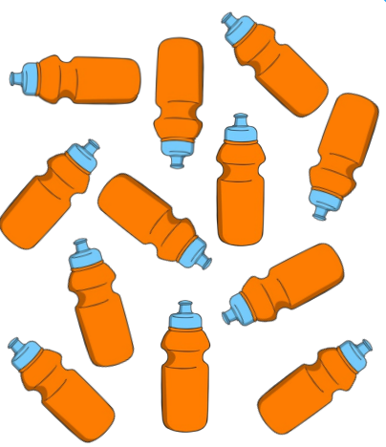
LQ: Can I find quarters for amounts?
24.04.24
Share these into quarters and answer the questions.
What is the whole?
How many is in each part?
What is 1 quarter?
Adult to use the crossing out method when sharing one by one.

Slide 34
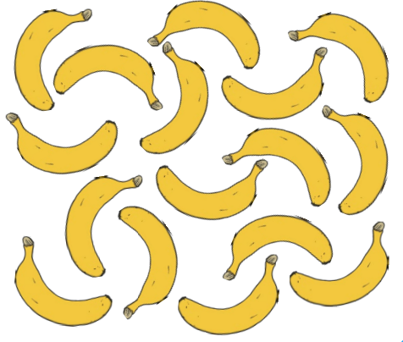
LQ: Can I find quarters for amounts?
24.04.24
Share these into quarters and answer these questions.
What is the whole?
How many is in each part?
What is 1 quarter?
Adult to use the crossing out method when sharing one by one.

Slide 35
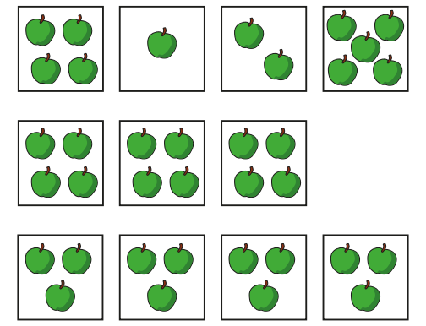
LQ: Can I find quarters for amounts?
24.04.24
Which row of pictures show quarters?
The bottom row shows quarters
because there are 4 equal parts.
Self assessment
Do you understand what quarters
mean?

Slide 36
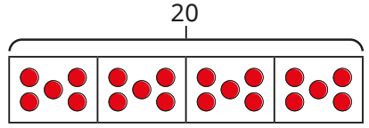
LQ: Can I find quarters for amounts?
24.04.24
Complete the sentence.
TPs: A quarter of 12 is ______.
Complete the sentence.
TPs: A quarter of 20 is ______.

Slide 37
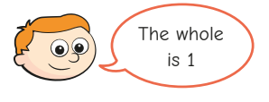
LQ: Can I find quarters for amounts?
24.04.24
A quarter of a number is 4.
TPs: Do you agree with Ron?
Explain your answer.

Slide 38
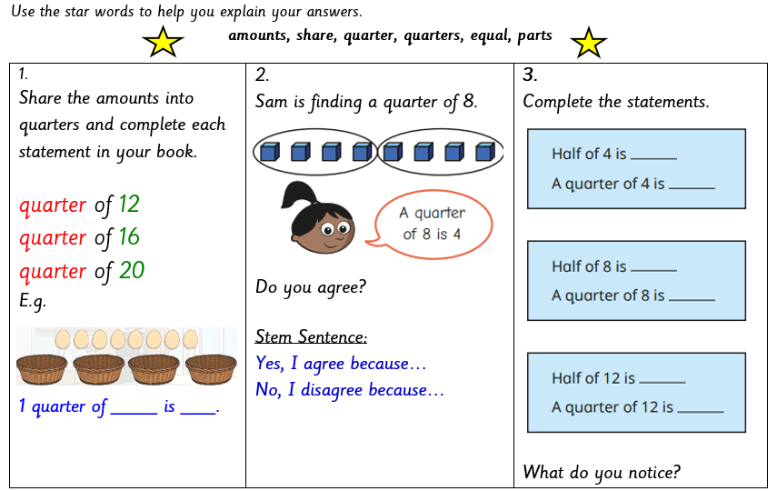
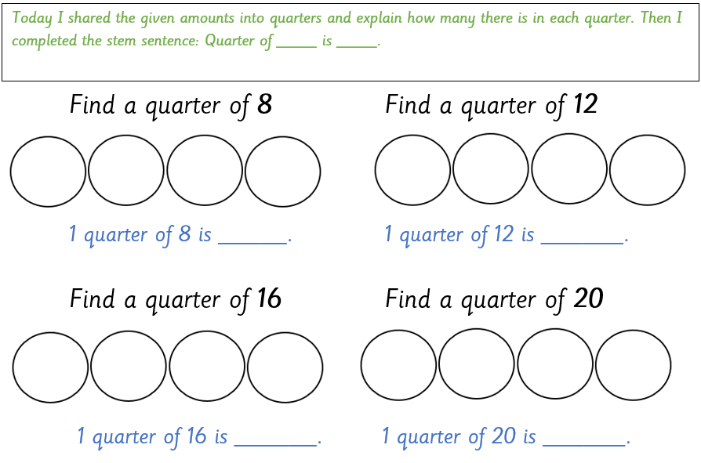
Task
24.04.24
LQ: Can I find quarters?
Self assessment
Do you understand the tasks?

Slide 39
Thursday 25th April 2024

Slide 40
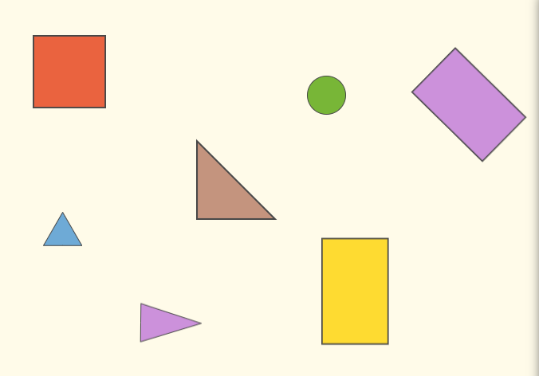
L.Q. Can I name the 2D shapes and count each side.
25.04.24
TP: This is a _____.
TP: It has _____ equal sides.

Slide 41
25.04.24
LQ: Can I describe turns?
Steps to success
I can describe the turn of an object using the words ‘quarter’, ‘half’, ‘three-quarter’ and ‘whole’.
I can recognise that a half turn will be facing the opposite way.
I can recognise that a whole turn will result in facing the same way.

Slide 42
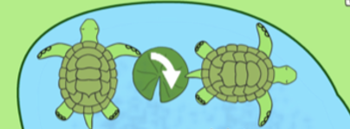
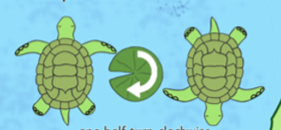
Star words
one whole turn
one quarter turn
Clockwise/right
anti-clockwise/left
half a turn

Slide 43
LQ: Can I describe turns?
25.04.24
Let’s join in with a direction dance.
https://www.youtube.com/watch?v=_wSq0ZOHugg
Let’s practice doing turns with our body.
We are going to use quarter turn, half turn, three quarter turn and full turn.

Slide 44
LQ: Can I describe turns?
25.04.24
Name That Turn
Watch the shape carefully and describe the turn.
Is the shape making a quarter or a half turn?
The triangle made a turn.
half

Slide 45
LQ: Can I describe turns?
25.04.24
Name That Turn
Watch the shape carefully and describe the turn.
Is the shape making a quarter or a half turn?
The rectangle made a turn.
quarter

Slide 46
LQ: Can I describe turns?
25.04.24
Name That Turn
Watch the shape carefully and describe the turn.
The rhombus made a turn.
quarter

Slide 47
LQ: Can I describe turns?
25.04.24
Name That Turn
Watch the shape carefully and describe the turn.
The semicircle made a turn.
half

Slide 48
LQ: Can I describe turns?
25.04.24
Name That Turn
What will the triangle look like after making a quarter turn?
Were you correct?

Slide 49
LQ: Can I describe turns?
25.04.24
Name That Turn
What will the oval look like after making a quarter turn?
How did you know?

Slide 50
LQ: Can I describe turns?
25.04.24
Lets pretend our finger is a ladybird. Point to the direction the ladybird will be facing after I command the turn.
CT: Command at random
half turn
quarter, turn
whole turn
three quarter turn
left
right
Self assessment
Do you understand how to
describe the turn?
Notes:
Teacher to command turns. (half turn, quarter, turn, whole turn, three quarter turn)

Slide 51
LQ: Can I describe turns?
25.04.24
Can you describe the turn the bee has made?
whole turn
quarter turn
Notes:
Model on flipchart

Slide 52
LQ: Can I describe turns?
25.04.24
Can you describe the turn the bee has made?
Half turn
Three- quarter turn
Self assessment
Do you know how to describe
the turns?
Notes:
Model on flipchart

Slide 53
LQ: Can I describe turns?
25.04.24
Can you describe the turn the bee has made?
TP: Does the bee show a half of a turn? How do you know?
Notes:
Model on flipchart

Slide 54
LQ: Can I describe turns?
25.04.24
Can you describe the turn the bee has made?
TP: Does the bee show a quarter of a turn? How do you know?
Notes:
Model on flipchart

Slide 55
LQ: Can I describe turns?
25.04.24
Can you describe the turn the bee has made?
TP: Does the bee show a three quarters of a turn? How do you know?
Notes:
Model on flipchart

Slide 56
LQ: Can I describe turns?
25.04.24
Task
Let’s go outside and play Simon says to practice doing turns with our body again.
We are going to use quarter turn, half turn, three quarter turn and full turn.

Slide 57
Friday 26th April 2024
WOW DAY
Trip to London

